Slide 1


Power Query Table Functions Part 6

Slide 2
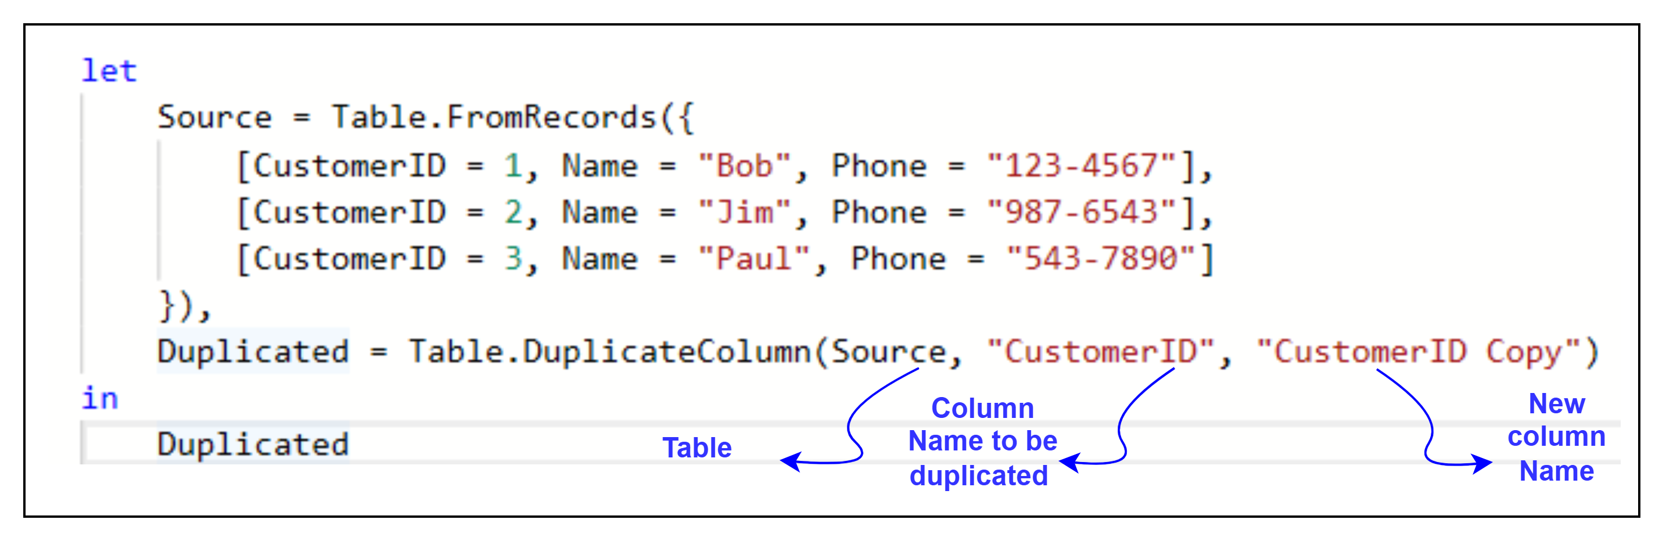
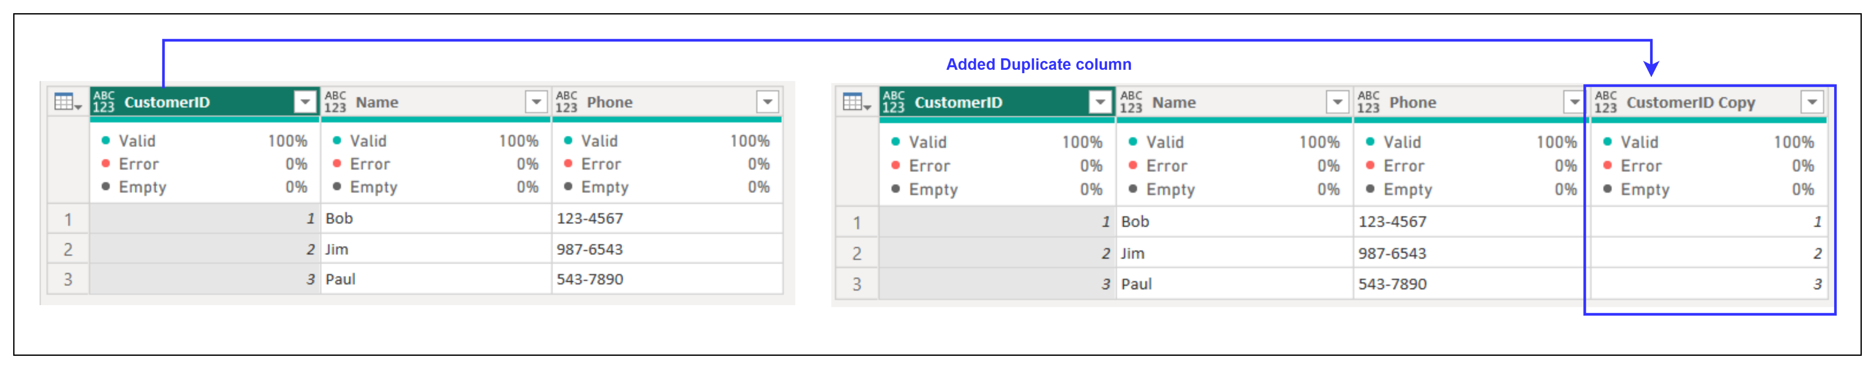
1. Table.DuplicateColumn
Description: Creates a duplicate of a specified column in the table.
Example:
Result:
Use Cases:
Creating backups of columns before transformation.
Testing different calculations on the same data.

Slide 3
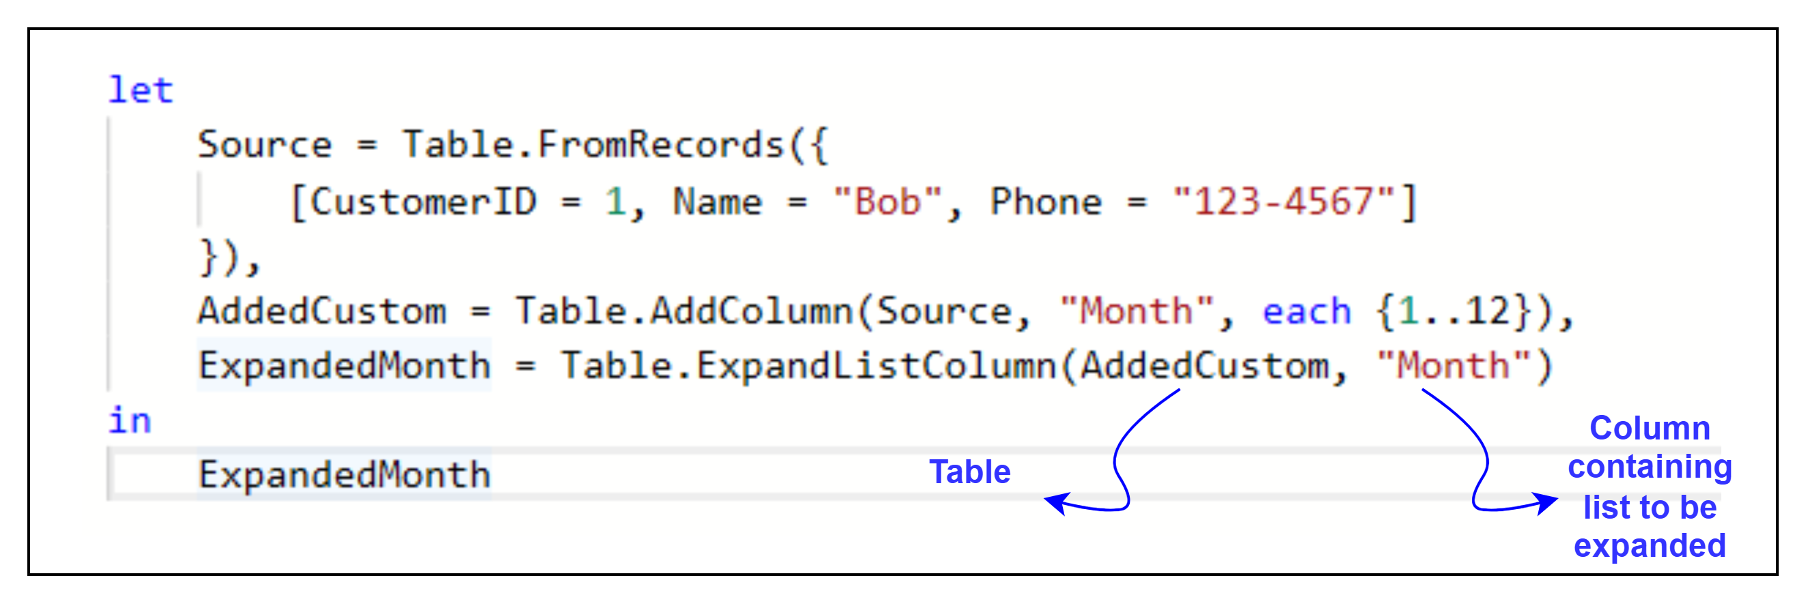
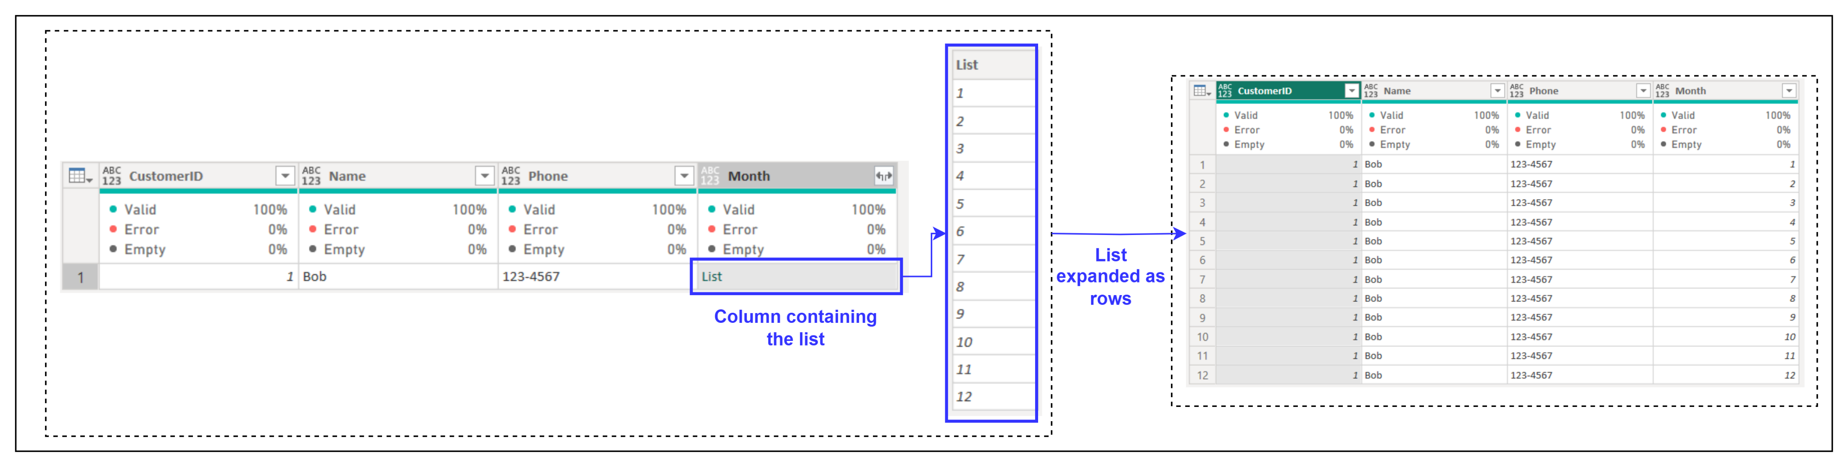
2. Table.ExpandListColumn
Description: Expands a column containing lists into multiple rows, repeating other column values.
Example:
Result:
Use Cases:
Flattening nested lists into individual rows for analysis.
Preparing same rows for monthly or yearly data.

Slide 4
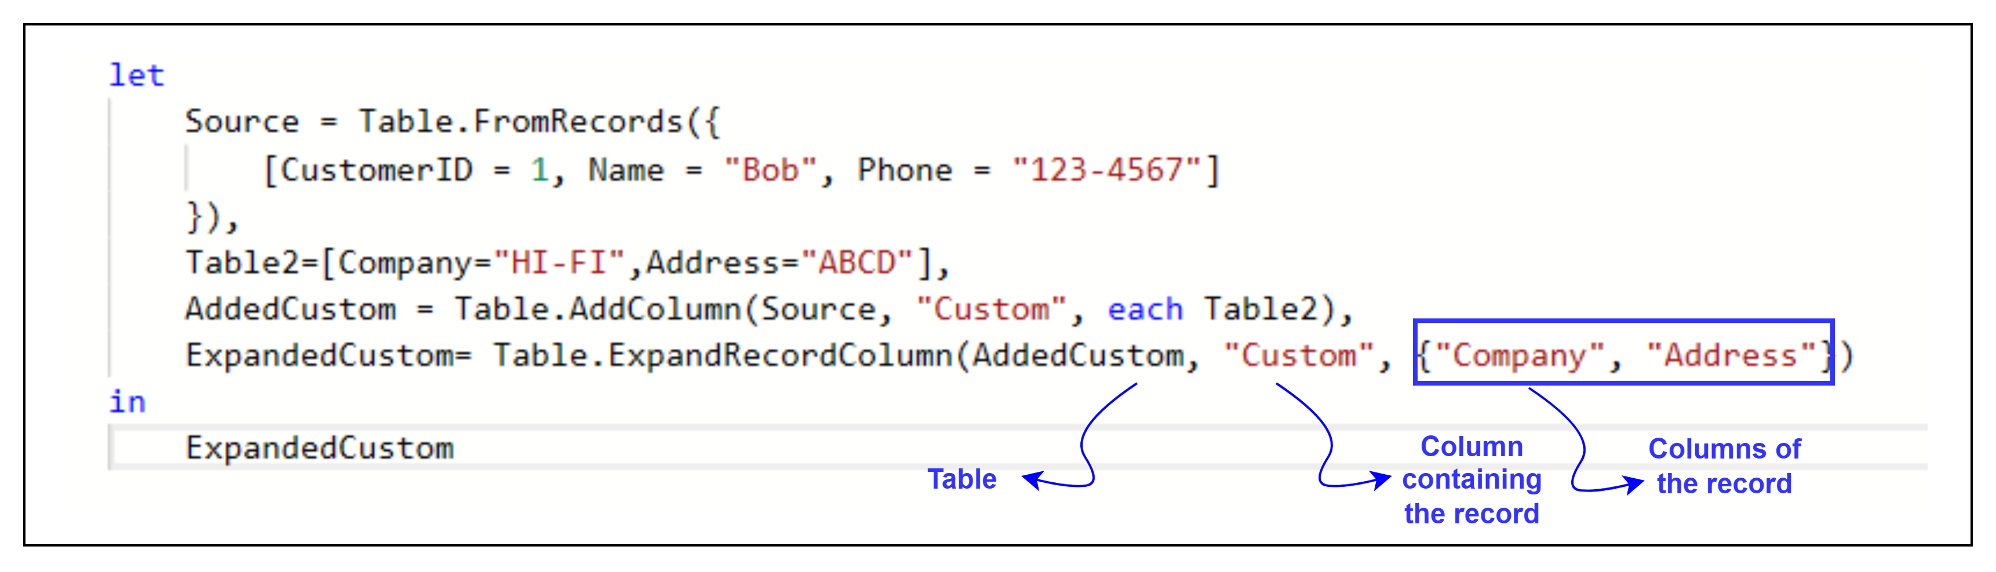
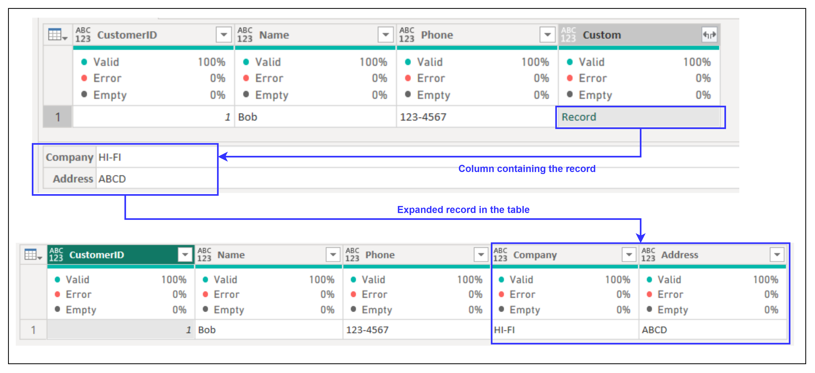
3. Table.ExpandRecordColumn
Description: Expands a column containing records into individual columns.
Example:
Result:
Use Cases:
Extracting fields from complex data structures like records.
Normalizing hierarchical data.

Slide 5
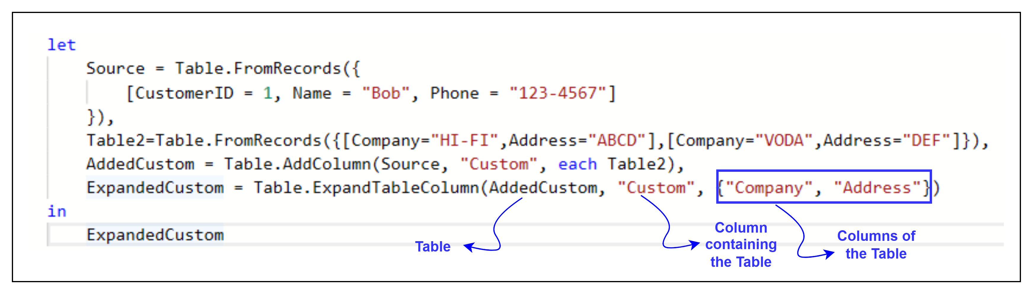
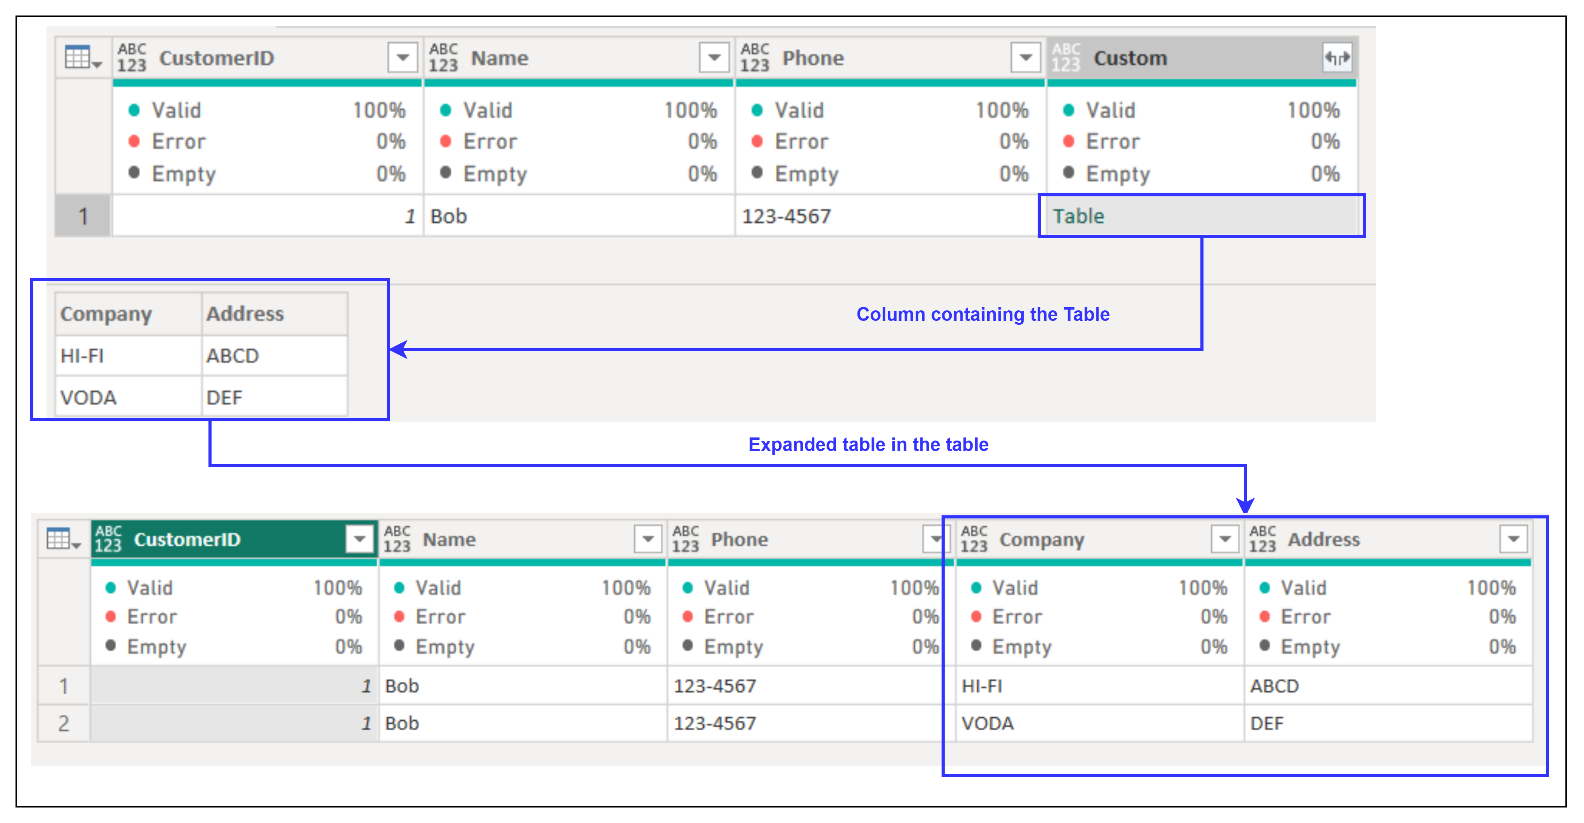
4. Table.ExpandRecordColumn
Description: Returns a table with duplicate rows removed.
Example:
Result:
Use Cases:
Combining nested tables into a single table.
Flattening hierarchical or relational data.

